Slide 1
Superconducting radiofrequency cavities –
An introduction
Ram C. Dhuley
USPAS – Cryogenic Engineering
June 21 – July 2, 2021

Slide 2
Goals of this lecture
SRF is a humongous topic! – offered as a separate 3-credit USPAS course
Here, we will look at basics of SRF cavities including the topics of:
  Working principle
  Figures of merit
  Cavity types
  Processing techniques for performance enhancement
Look at some new frontiers in SRF

Slide 3
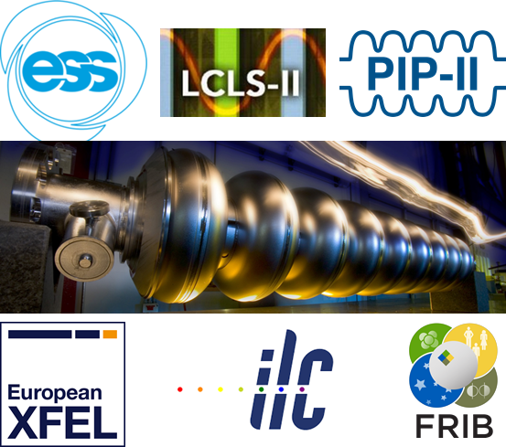
Introduction
Superconducting radiofrequency (SRF) cavities
A technology for production of energetic particle beams,
Invented half-a-century ago, matured via solid R&D
One of the two largest applications of low temperature superconductivity
Today, SRF cavities is a core technology used in the construction of large linear particle accelerators for discovery science
Electron-positron collider
X-ray/light sources
Neutron, neutrino production
Acceleration of rare isotopes, heavy ions

Slide 4
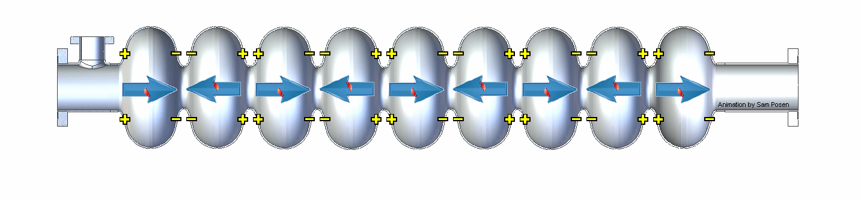
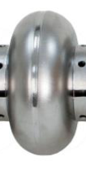
RF cavity working principle
Metallic cells maintain a standing-wave RF field
Particle bunches in phase with the RF field gain energy
RF fields penetrate a penetration depth, δ the metallic cell walls and dissipate heat in the surface resistance, R_{s}
A coolant on the outside extracts the heat and prevents the cavity from heating above its design temperature
RF fields
Metal wall
Coolant
heat

Slide 5
RF surface resistance
Why is RF surface resistance a key parameter?
Dissipated power in the cavity is proportional to its surface resistance
The cost of cooling the cavity (coolant fluid, temperature, fluid pumping power, etc.) scales with dissipated power
With hundreds of cavities in a particle accelerator, the cavity cooling cost forms a significant fraction of accelerator operating cost
Keeping low RF surface resistance is therefore necessary to reduce the accelerator operating cost.

Slide 6
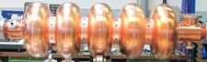
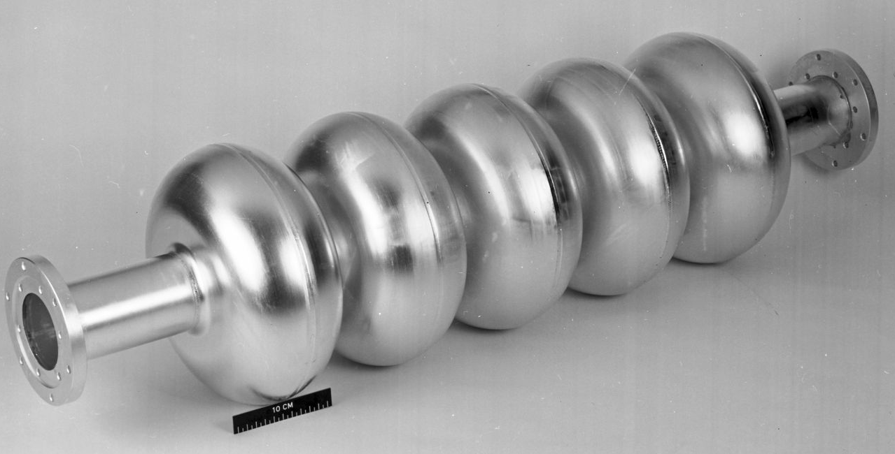
Normal vs. superconducting cavities
How does the surface resistance compare?
Water cooled copper cavity near room temperature
Liquid helium cooled niobium cavity ≤ ~5 K
ω = angular frequency
σ = electrical conductivity
With σ ~ 5.8 x 10⁷ S/m at 1.5 GHz and 300 K, we get R_{s} = 10 mΩ
At 1.5 GHz and 2 K, and neglecting the residual R_{res}, we get R_{s} = 20 nΩ

Slide 7
Normal vs. superconducting cavities
Ratio of surface resistance
at 1.5 GHz:
Penalty for 2 K cryogenics:
Even after accounting the premium for 2 K cryogenics, SRF drives down the cooling driven operating cost by a factor ~1000 !!!
The significantly lower surface resistance in SRF also offers other benefits:
Cavities can be operating with 100% RF duty cycle that facilitate production of high average power particle beams
Cavities can be made with larger aperture (by relaxing shunt impedance) that reduce loss of high-power beams during transport through the cavity

Slide 8
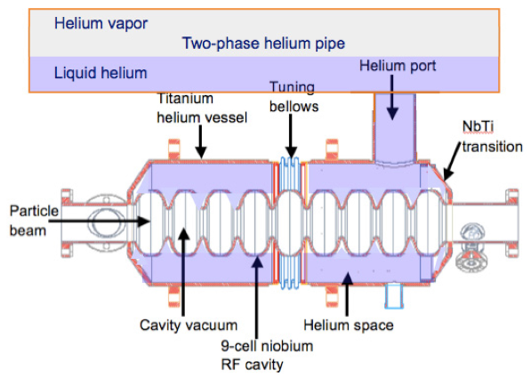
Helium cooling of SRF cavities
Liquid helium 1.8 – 4.2 K
https://lss.fnal.gov/archive/test-tm/2000/fermilab-tm-2620-td.pdf

Slide 9
Optimal operating temperature with helium?
The surface resistance goes up with frequency and down with temperature: lower temperature equals less resistance, particularly at higher frequencies
What is the optimal temperature?
  Above about 500 – 700 MHz you win by operating below 4.2 K ( typically 1.8 – 2 K)
  At lower frequencies (eg. 80 MHz) you are better at 4.2 K thermodynamically but there may be other considerations (FRIB)
  Between these limits it’s a fairly broad minimum. Most systems operate ~ 2 K – He II
Content courtesy: J. G. Weisend II (ESS)

Slide 10
SRF accelerators under operation/construction
Name | Accelerator Type | Lab | T (K) | Refrigeration Capacity | Status
CEBAF | Electron Linac | JLab | 2.1 | 4.2 kW @ 2.1 K | Operating
12 GeV Upgrade | Electron Linac | Jlab | 2.1 | 4.2 kW @ 2.1 K | Operating
ESS | Proton Linac | ESS | 2.0 | 3 kW @ 2 K | Under Construction
PIP-II | Proton Linac | Fermilab | 2.0 | 2.4 kW @ 2 K | Under design
E Linac | Electron Linac | TRIUMF | 2.0 | 288 L/Hr | Operating
S-DALINAC | Electron Linac | TU Darmstadt | 2.0 | 120 W @ 2.0 K | Operating
XFEL | Electron Linac | DESY | 2.0 5 -8 40-80 | 2.5 kW @ 2 K 4 kW@ 5 -8 K 26 kW @ 40-80 K | Under construction
ATLAS | Heavy Ion Linac | ANL | 4.7 | 1.2 kW @4.7 | Operating
LCLS II | Accelerator | SLAC | 2.0 K | 8 kW @ 2 K 2.6 kW @ 4.5 -6 K | Under construction
ISAC - II | Heavy Ion Linac | TRIUMF | 4 |  | Operating
FRIB | Heavy Ion Linac | MSU | 2.1 4.5 | 3.6 k W @ 2.1 K 4.5 kW @ 4.5 K | Under Construction
Content courtesy: J. G. Weisend II (ESS)

Slide 11
SRF cavity – figures of merit
Accelerating gradient, E_{acc}
defined as the ratio of the accelerating voltage, V_{c}, divided by the cavity length, L. V_{c} is obtained by integrating the electric field at the particle’s position as it traverses the cavity:
= RF frequency
= speed of light in vacuum
= beam travel direction
Intrinsic quality factor, Q₀
defined as the ratio of the energy stored, U_{stored} divided by the
energy dissipated in in one RF period, P_{diss}
= shape factor (a constant)
= surface resistance
= magnetic field (A/m)

Slide 12
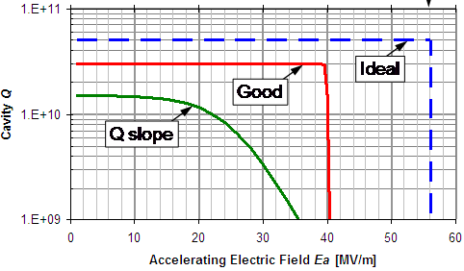
SRF cavity – figures of merit
Only BCS resistance
BCS + residual resistance
Higher Q₀ = Lower cryogenic heat load
Real ‘high-field’
Losses (HFQS)
Higher E_{acc} = Larger energy gain per length

Slide 13
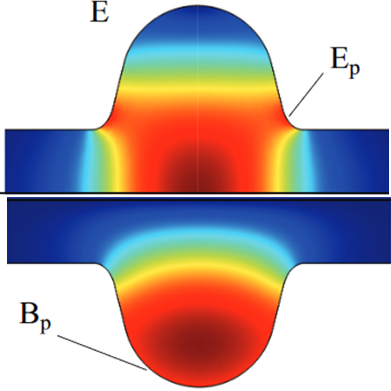
SRF cavity – figures of merit
Peak field ratios (geometry dependent only, smaller are better)
Determines max. E_{acc} that can be generated before reaching quench magnetic field at the cavity surface
Determines max. E_{acc} that can be generated before E_{peak} induced field emission sets in
Shunt impedance, R_{sh} (geometry dependent only, larger is better)
A measure of voltage that can be generated for a given dissipated power
(analogous to Ohm’s law)

Slide 14
Dissipated power
E_{acc}L = Voltage gain – dictated by end-application
DF = RF duty factor – fraction of unit time when the RF power supply is ON; usually dictated by end-application
P_{diss} = Cryogenic load – need to minimize this to lower the cost of refrigeration
R_{sh}/Q*G = Geometry factor – should be made as high as practical;
this is optimized using FEA codes during cavity design stage
R_{s} = R_{res} + R_{BCS}(T) = RF surface resistance – must be kept small;
several recipes for surface treatment have been developed to reduce R_{res}

Slide 15
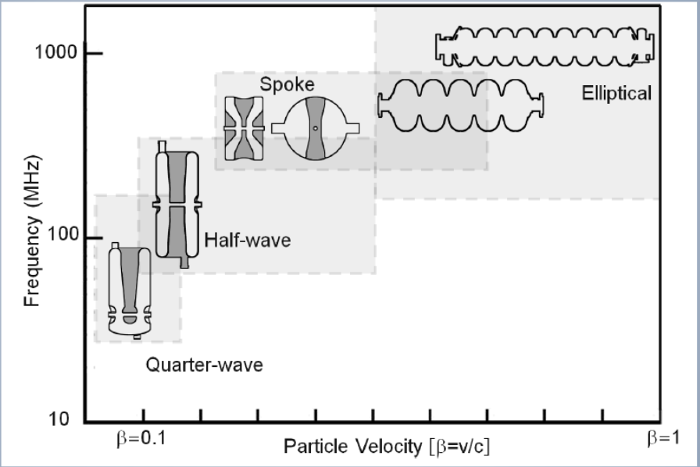
SRF cavity types
Source - E. Jensen, SRF tutorial, EuCAS 2017
Electrons are ‘light’ and attain β ≈1 over ‘short’ acceleration distance
Can use elliptical cavities immediately after injector
Protons and ions are ‘heavy’ and need gradual acceleration over long length
Start with low-β cavity after injector followed by cavities with gradually increasing β

Slide 16
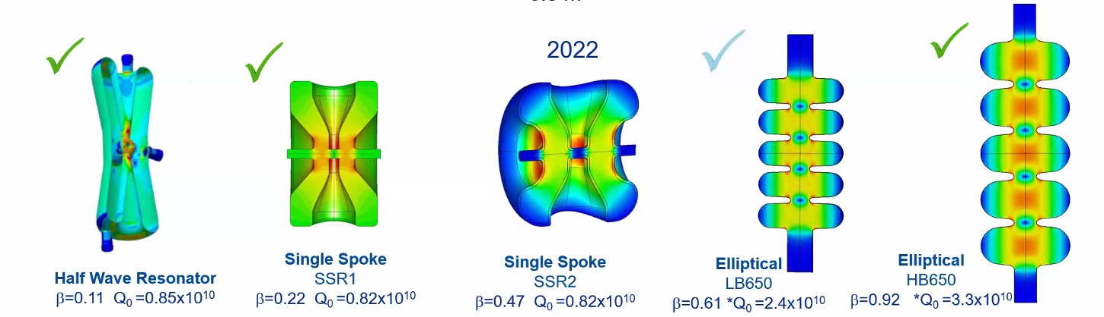
SRF cavities for Fermilab PIP-II
PIP-II is a proton accelerator being built at Fermilab
that will provide 800 MeV proton beam for neutrino experiments
162.5 MHz,
v/c = 0.11
325 MHz
v/c = 0.22
325 MHz,
v/c = 0.47
650 MHz,
v/c = 0.61
650 MHz,
v/c = 0.92
Increasing proton energy

Slide 17
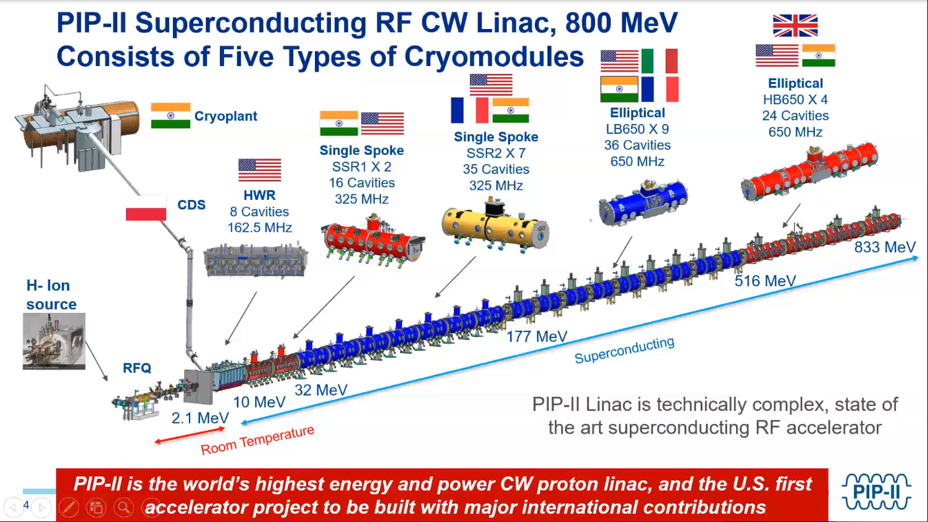
PIP II linac layout
Content courtesy: PIP II integration team

Slide 18
SRF cavity material (Courtesy: Sam Posen, FNAL)
Niobium has been the material of choice for SRF cavities for the last ~50 years
Some of the best superconducting properties of all elements including highest critical temperature T_{c} ~ 9.2 K and high H_{c1} ~190 mT
Easy metallurgy – purify, make sheets, form, weld, heat treat. No need to achieve precise stoichiometry as niobium is not a compound or alloy
Good structural and thermal properties in bulk form, doesn’t react with water
SRF grade niobium is RRR > 300 that provides good bulk thermal conductivity for heat conduction from RF surface to helium coolant
Some accelerators (eg. LEP at CERN) used bulk copper cavities sputtered with a few microns of niobium on the inner RF surface

Slide 19
Surface processing techniques
Niobium cavities are produced from bulk sheets deep drawn into the desired shape (eg. elliptical half-cells) and then e-beam welded together
The cavities undergo several heat/surface treatments before assembly in an accelerator. The goals are to:
  Repair the RF surface as well as reduce bulk stresses arising from the fabrication processes
  Enhance the surface RF properties for maximizing Q0
Common steps (both done to all cavities):
  Bulk electropolishing – 100-200 um of ‘damaged’ RF surface is removed
  800 ⁰C bake in vacuum for ~3 hours (aka high T bake) – reduce residual stress, improve microstructure, remove absorbed hydrogen during fabrication process

Slide 20
Surface processing techniques
Special treatments – these are selected according to the desired performance (Q₀ and E_{acc}):
  Buffer Chemical Polishing (BCP):
    10-20 um of RF surface is etched using 1:1:2 solution of hydrofluoric, nitric and phosphoric acids
    Cavities shows good performance up to ~20 MV/m followed from Q-slope
  Electropolishing:
    10-20 um of RF surface is etched using hydrofluoric and sulfuric acids usually with ratio 1:10
    Cavities shows good performance up to ~25 MV/m followed from Q-slope
  Low T bake:
    Vacuum baking at 120 ⁰C for ~48 hours
    Cavities do not see the Q-slope and gradient up to ~40 MV/m can be attained

Slide 21
Surface processing techniques
Special treatments – these are selected according to the desired performance (Q₀ and E_{acc}):
  Nitrogen doping:
    After high T bake, nitrogen is let in the furnace at a constant pressure of 25 mTorr;
    cavity is let to anneal for several minutes and then heating is stopped
    The cavity is cooled and then 5-10μm of material is removed by electropolishing
    Eacc can be pushed beyond 50 MV/m
  Nitrogen infusion:
    After high T bake, the furnace temperature is lowed to 120-160 ⁰C
    Nitrogen is let in at 25 mTorr
    Temperature is held steady for ~48 hours
    No chemical treatment done after cooling the cavity to room temperature
    The technique produces very high Q₀ and highest E_{acc}

Slide 22
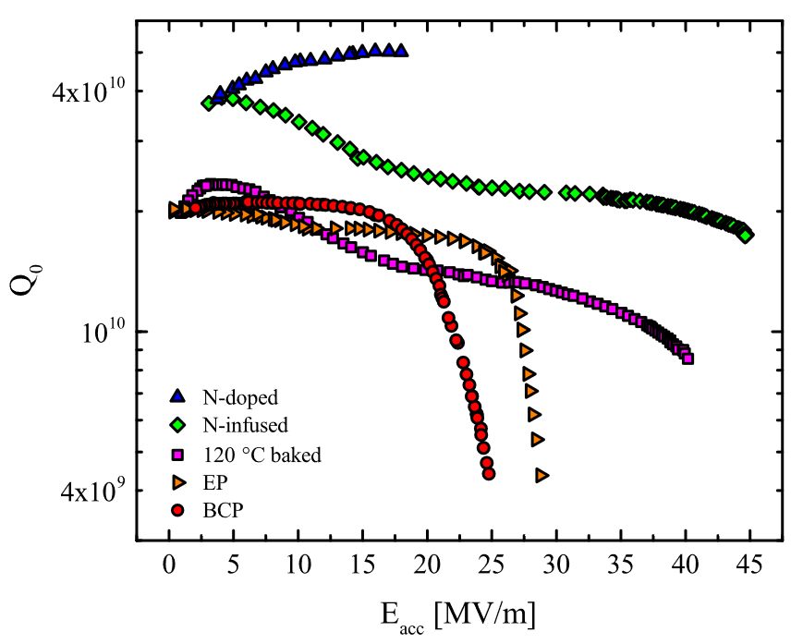
Effect of surface treatments on performance
(M. Checchin, FNAL)
HFQS ~20 MV/m
HFQS ~25 MV/m

Slide 23
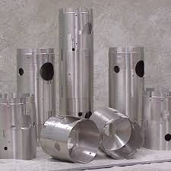
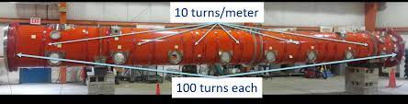
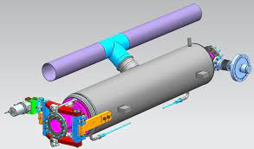
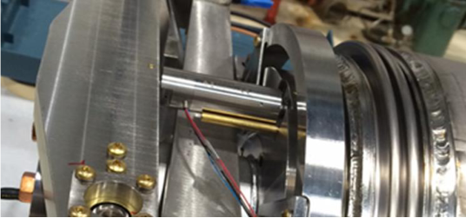
Practically important aspects of SRF cavities
Local magnetic fields ( including the Earth’s) degrade cavity performance (Q₀)
  Result is that cavities are designed with passive and sometimes active magnetic shields. Use of magnetic materials near cavities must be carefully examined
Cavities are resonant structures that require tuning frequently at cryogenic temperatures
Vibrations (microphonics) can detune cavities depending on cavity stiffness and design
  This may put strict limits on vibrations near cavities
  Use of He II (see lecture on superfluid helium) prevents bulk boiling in the helium bath that may affect the cavity tune
Magnetic shields provide
passive shielding
Current coils around cryomodule actively negate the magnetic field inside
Tuner for
LCLS II cavities
Content courtesy: J. G. Weisend II (ESS)

Slide 24

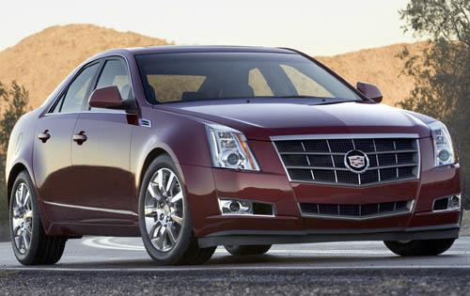
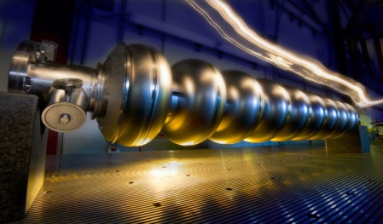
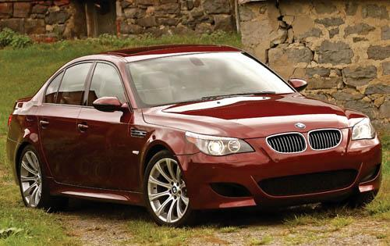
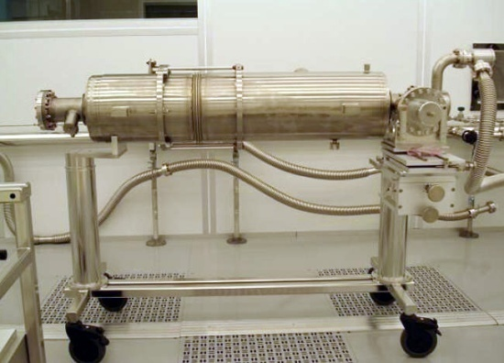

SRF cavities – cost perspective
$40k
Cadillac
CTS
Processed
One-Cell
$85k
BMW
M5
New
Nine-Cell
$250k
Aston Martin
DBS
Dressed
Nine-Cell
Content courtesy: A. Rowe (Fermilab)

Slide 25
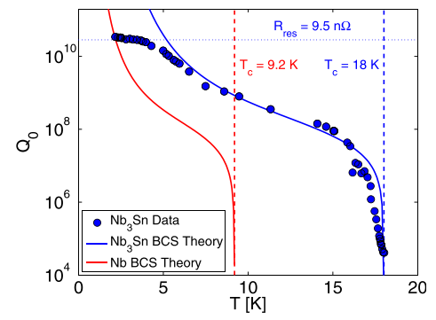
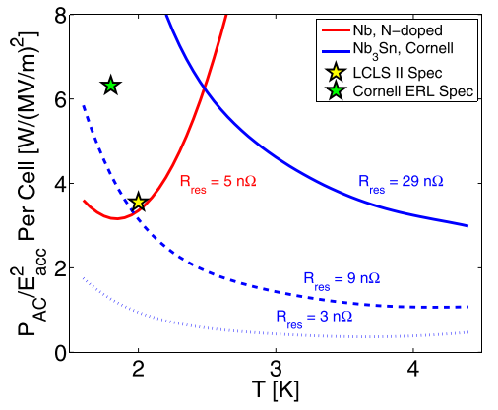
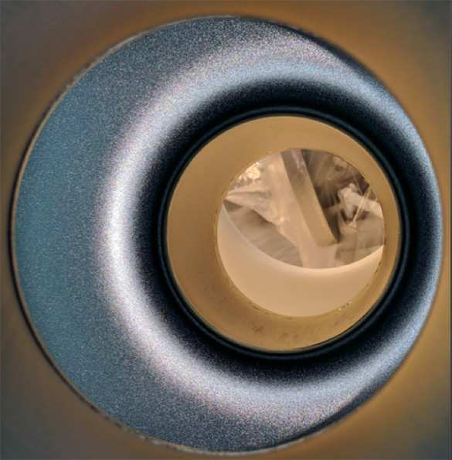
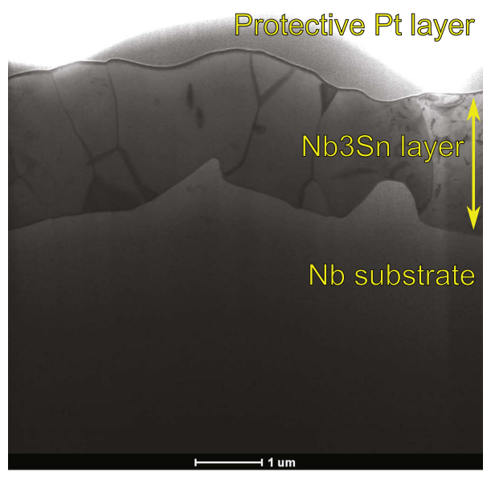
New frontiers in SRF
Nb₃Sn as an alternative to traditional niobium
Superconductor with T_{c} ≈ 18 K, almost twice that of niobium’s 9.2 K
Has significantly lower R_{BCS} than niobium at liquid helium temperatures < 4.2 K
If R_{res} is kept small (by ensuring proper stoichiometry, surface treatments, and magnetic shielding), Nb₃Sn cavities exhibit very high Q₀ even at ~4 K
  An accelerator can be operated with 4.2 K LHe systems, which are much cost effective compared to 2 K helium systems needed for niobium cavities
Active research areas – growing thin layer of Nb₃Sn on inner walls of niobium cavities; cooling and mag-shielding techniques to minimize trapped flux
DOI: 10.1088/1361-6668/30/3/033004

Slide 26
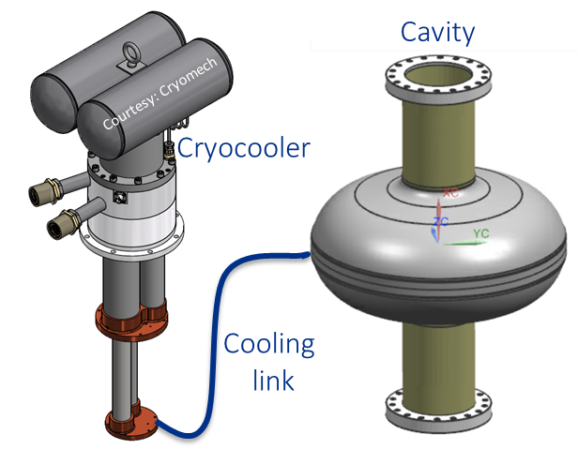
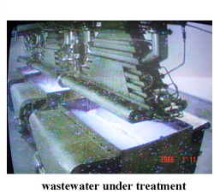
New frontiers in SRF
Cryogen-free, cryocooler conduction cooled SRF cavities
Use closed-cycle 4 K cryocoolers and conduction links to extract P_{diss} from Nb3Sn SRF cavities
  Liquid helium around the SRF cavity not needed
  -> no cryoplant, no distribution or recovery system
  -> no complex pressure vessel design of the cryomodule
Cryocoolers are plug-n-play machines that turn on/off with the push of a button
  Unlike helium cryo-plants that are operationally complex
Potential use of conduction cooled SRF in e-beam irradiation machines for industrial applications:
  Industrial and municipal waste-water treatment
  Medical device sterilization, medical waste treatment
Active research areas
  Design of cavities and thermal links for SRF conduction cooling
  Design of low heat leak, magnetically shielded, compact cryomodules

Slide 27
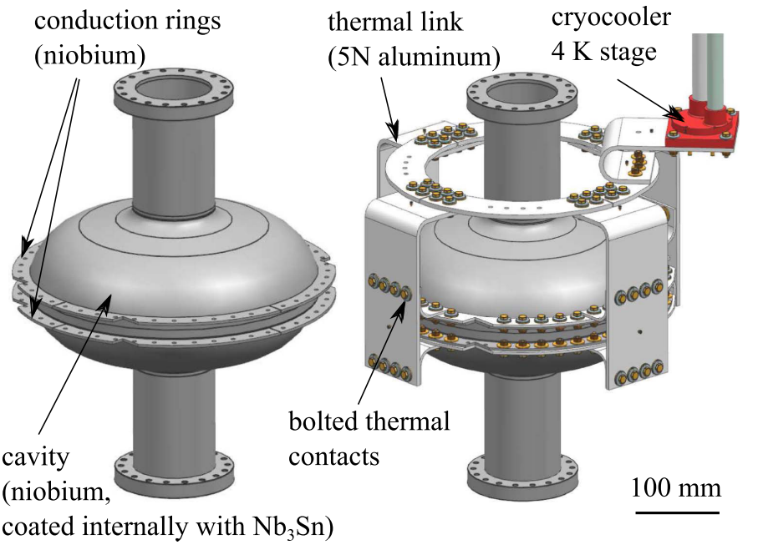
New frontiers in SRF
Fermilab efforts for conduction cooled SRF cavity development

Slide 28
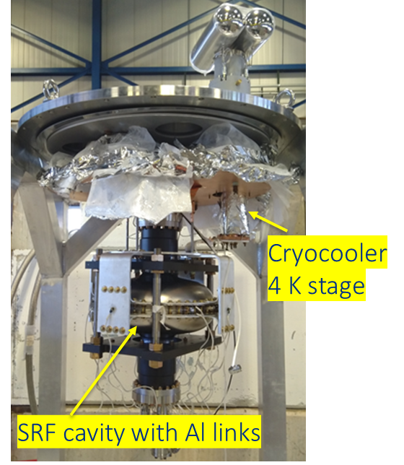
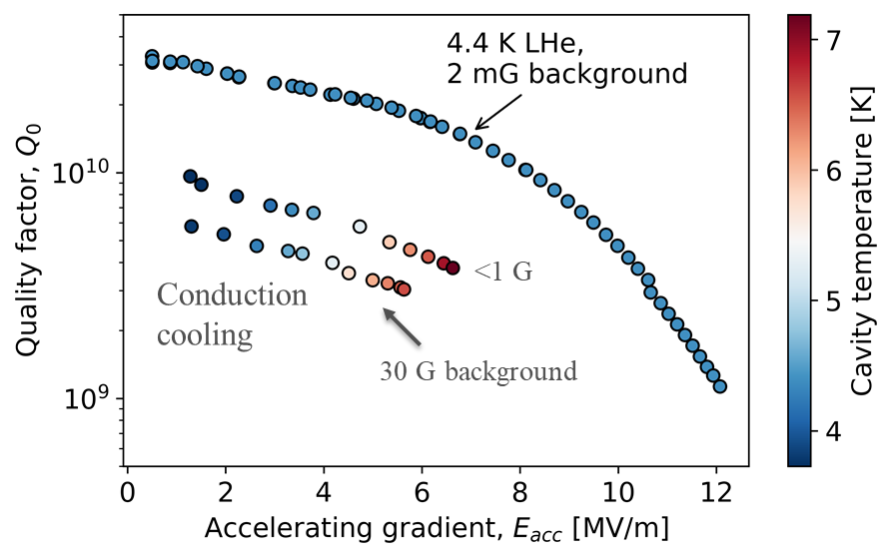
New frontiers in SRF
Fermilab efforts for conduction cooled SRF cavity development
Conduction cooled SRF
test setup at Fermilab
World’s first demonstration of practical E_{acc} on a conduction cooled SRF cavity
R.C. Dhuley et al., https://doi.org/10.1088/1361-6668/ab82f0

Slide 29
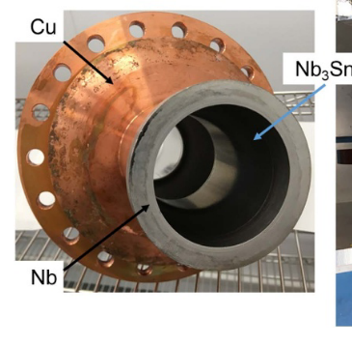
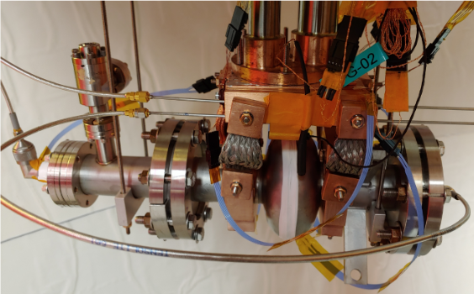
New frontiers in SRF
Other ongoing efforts for conduction cooled SRF cavity development
Jefferson Lab
Cornell University
https://doi.org/10.1088/1757-899X/755/1/012136
https://arxiv.org/abs/2002.11755
1.5 GHz
Cold sprayed +
electrodeposited copper
2.6 GHz
Copper clamps

Slide 30
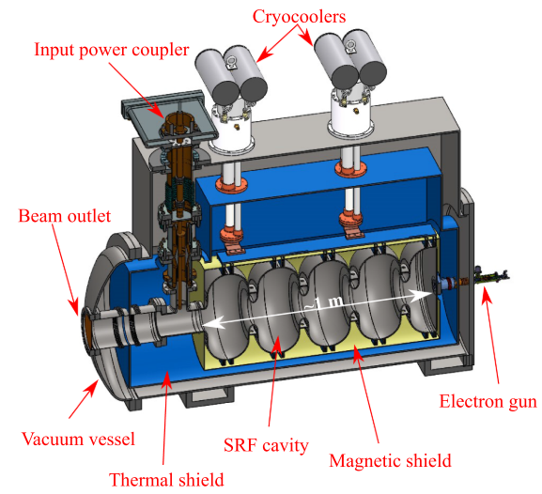
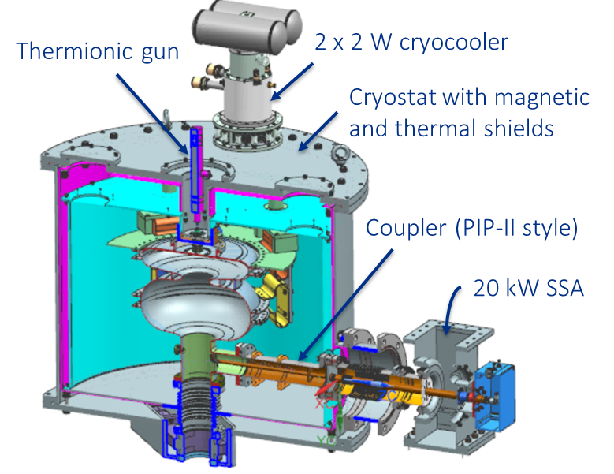
New frontiers in SRF
Compact e-beam accelerator development at Fermilab using conduction cooled SRF cavities

Slide 31
Further reading
Hasan Padamsee, “RF Superconductivity for Accelerators,” Wiley-VCH; 2nd edition (February 26, 2008)
Hasan Padamsee, “RF Superconductivity: Science, Technology, and Applications,” Wiley-VCH; 1st edition (April 20, 2009)
G. Ciovati, “AC/RF Superconductivity,” arXiv:1501.07398v1
A Grassellino et al 2017 Supercond. Sci. Technol. 30 094004
S Posen and D L Hall 2017 Supercond. Sci. Technol. 30 033004
R C Dhuley et al 2020 Supercond. Sci. Technol. 33 06LT01
Gianluigi Ciovati et al 2020 Supercond. Sci. Technol. 33 07LT01
T. Khabiboulline, “Engineering for Particle Accelerators,” https://uspas.fnal.gov/materials/17NIU/SRF%20Cavity.pdf

